Slide 1
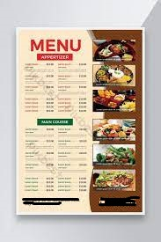
Problem Solving 1
🍽️ Core Functionalities for a Restaurant Ordering System
display_menu()
Shows available meals with prices and categories (e.g., appetizers, main course, drinks, desserts).
take_order()
Allows customers to select one or more items from the menu.Can take item quantity and save it in an order list/cart.
update_order(item, quantity)
Lets customers change the quantity or remove an item from their order.
calculate_total(order_list)
Calculates subtotal based on selected items and quantities.
apply_discount_or_tax(total)
Adds tax and optionally applies discount codes or loyalty points.
print_final_bill(order_list, total_with_tax)
Prints a detailed bill showing:
Items ordered
Quantity and unit price
Subtotal, tax, discount
Final total amount due
confirm_order()
Asks customer to confirm before proceeding to payment.
process_payment(method)
Simulates cash, card, or mobile payment options.
issue_receipt()
Generates a printed or digital receipt with time, date, and order summary.
exit_system()
Closes the session gracefully after order completion.
Your task today is to help restaurant customers in ordering their favorite meals.
Write some functionalities required in your system including issuing final bills.

Slide 2
Problem Solving 2
Use of if, elif, else and not will allow my program to be more simulative and allow more options for customers.
For their bills we can give messaging options like paying with card or cash and whether they’d like a receipt or an online track of the order through sms.
Prompt of meal choices and then sub-categories.
Customers enjoy looking at menu options. Can you think about how to simulate this by useful messages and options to be printed on the screen?
What about displaying their bills?

Slide 3
Problem Solving 3
Scenario 1-user wants to chose what to order
Output= he will be given options to chose from and once chosen a drop-down list of items with prices will be listed
Scenario 2-wants bill
Output=calculation of total bill will be given to be paid for
Write two scenarios showing how users might use your program in each scenario write the expected input from users and what output should be displayed on screen.

Slide 4
Problem Solving 4
def breakfast():
def appetizers():
def main_course():
def side_dishes():
def drinks():
def desserts():
def menuoptions():
def restaurant_bill_order():
Scenario EXAMPLE:
def drinks():
print("water\nsoft beverages\niced tea\ncoffee")
inp = int(input("Enter order here"))
if inp == 1:
print("water AED 3")
elif inp == 2:
print("soft beverages AED 7")
elif inp == 3:
print("iced tea AED 7")
elif inp == 4:
print("coffee AED 16")
else:
print("Invalid input!")
In SE its recommended not to scatter your script all over. Write a program skeleton well organized with multiple functions and show the scenario of calls or invocation to each function.

Slide 5
Problem Solving 5
FUNCTIONALITY 1-option of spicy or normal
FUNCTIONALITY 2-paying with PayPal and/or cryptocurrency.
FUNCTIONALITY 3-complaint and rating section.
What might violate the system-
If someone wants a specific option like for example no cheddar cheese on pizza it could violate the system
If someone choses a number outside the option list it could violate the system
If some does not have sufficient funds on their card it could again violate the system.
Some resturants makes some offers to please their customers, some accepts payments through banking cards, some adds additional taxes on bills.
Think about additional functionalities that you wish to add to your system ?
And what scenarios might violate your system?

Slide 6
Problem Solving 6
def breakfast():
print("1-omellete\n2-sausages\n3-special breakfast burger")
inp = int(input("Enter order here"))
if inp == 1:
print("omelette AED 7")
elif inp == 2:
print("sausages AED 12")
elif inp == 3:
print("special breakfast burger AED 20")
else:
print("Invalid input!")
def appetizers():
print("french fries\nhummus\nchicken pastry")
inp = int(input("Enter order here"))
if inp == 1:
print("french fries AED 9")
elif inp == 2:
print("hummus AED 15")
elif inp == 3:
print("chicken pastry AED 5")
else:
print("Invalid input!")
Write the whole system script with the following functionalities:
Meals option menu
Taking customer orders
Calculating net payments
Displaying detailed bills
Meaningful error message for any violation
Run the program for each sucsessful and unsuccessful cases then take screenshots for your output screen.
Push your work into GitHub (this .ppt file, py file, and screenshots)

Slide 7
def main_course():
print("chicken(with lemon)\nkobe beef\nwaffle burger\nfriend chicken")
inp = int(input("Enter order here"))
if inp == 1:
print("chicken(with lemon) AED 21")
elif inp == 2:
print("kobe beef AED 130")
elif inp == 3:
print("waffle burger AED 45")
elif inp == 4:
print("friend chicken AED 25")
else:
print("Invalid input!")
def side_dishes():
print("calzone\nmac n cheese\ntomato soup")
inp = int(input("Enter order here"))
if inp == 1:
print("calzone AED 17")
elif inp == 2:
print("mac n cheese AED 15")
elif inp == 3:
print("tomato soup AED 11")
else:
print("Invalid input!")
def drinks():
print("water\nsoft beverages\niced tea\ncoffee")
inp = int(input("Enter order here"))
if inp == 1:
print("water AED 3")
elif inp == 2:
print("soft beverages AED 7")
elif inp == 3:
print("iced tea AED 7")
elif inp == 4:
print("coffee AED 16")
else:
print("Invalid input!")
def desserts():
print("tiramisu\nlava cake\nice cream sundae")
inp = int(input("Enter order here"))
if inp == 1:
print("tiramisu AED 20")
elif inp == 2:
print("lava cake AED 15")
elif inp == 3:
print("ice cream sundae AED 23")
else:
print("Invalid input!")

Slide 8
def menuoptions():
print("1: breakfast")
print("2: appetizers")
print("3: main course")
print("4: side dishes")
print("5: drinks")
print("6: desserts")
inp = int(input("Enter a number: "))
if inp == 1:
print("breakfast")
breakfast()
elif inp == 2:
print("appetizers")
appetizers()
elif inp == 3:
print("main course")
main_course()
elif inp == 4:
print("side dishes")
side_dishes()
elif inp == 5:
print("drinks")
drinks()
elif inp == 6:
print("desserts")
desserts()
else:
print("Invalid input!")
menuoptions()
def restaurant_bill_order():
print("\nRestaurant bill order.\n\nEnter the quantity of ordered items= ")
print("\n\nplease pay aed=")
restaurant_bill_order()

Slide 9
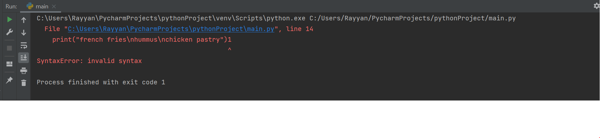
UNSUCCESSFUL RUN

Slide 10
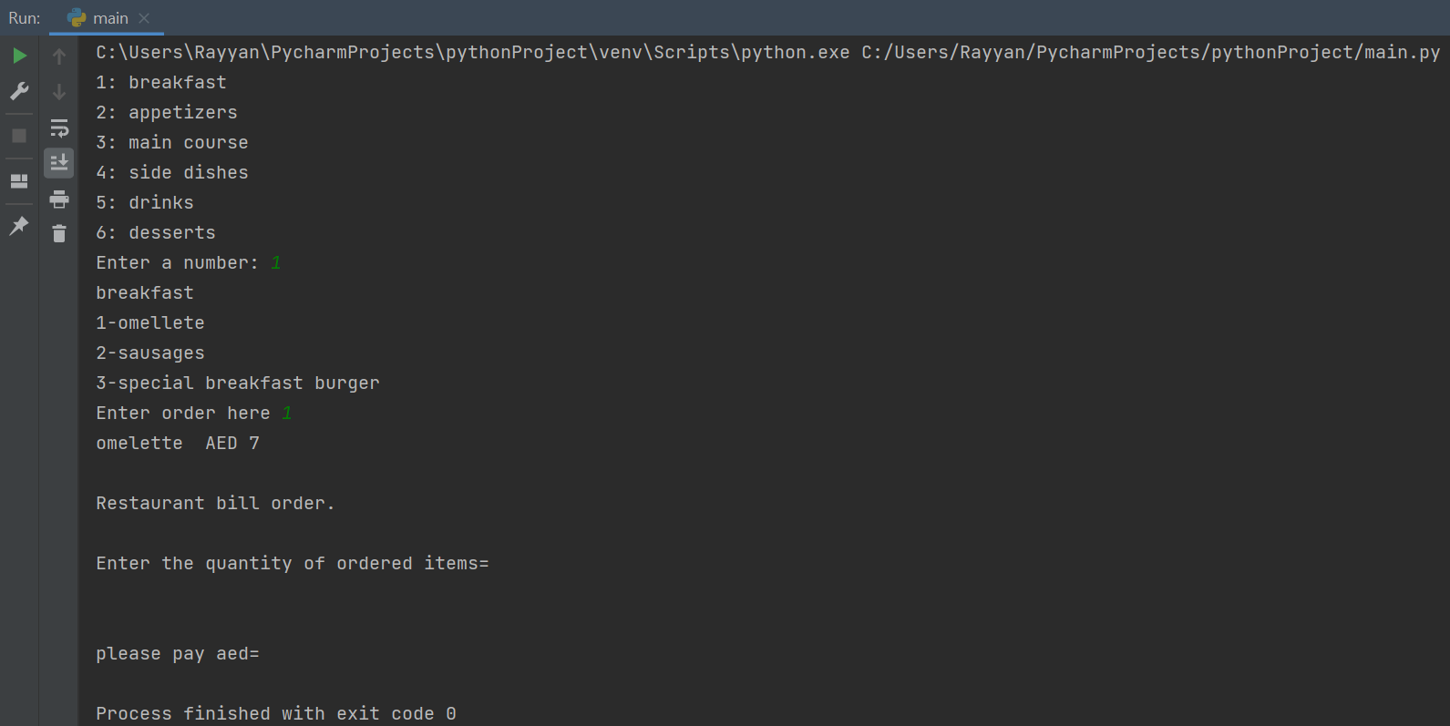
SUCCESSFUL RUN

